Slide 1

CSCI 297: Generative AI: Creating with Computation
Variational Autoencoders

Slide 2
History of VAEs
In 2013, Diederik P. Kingma and Max Welling published a paper that laid the foundations for a type of neural network known as a variational autoencoder (VAE)
Autoencoders are an older neural network architecture that excel at automating the process of representing raw data more efficiently for various machine learning and AI applications
In VAEs, the intermediate layer provides a way to represent data in a probability field that enables the layer to store more varieties and with greater precision

Slide 3
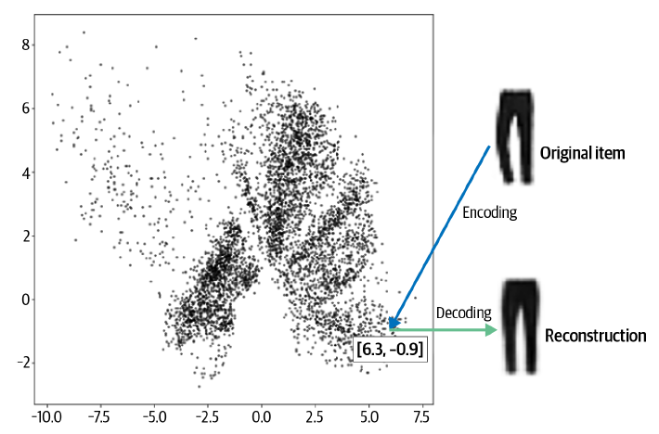

Understanding a Distribution

Slide 4
A Dense Representative Vector
Each location in the wardrobe is represented by two numbers
This vector is also known as an embedding because the encoder attempts to embed as much information into it as possible
The decoder can produce an accurate reconstruction so long as enough information is available within the encoding vector

Slide 5
What’s an Autoencoder
An autoencoder is simply a neural network that is trained to perform the task of encoding and decoding an item
Thus, the output is as close to the original item as possible with an expected amount of error
Why would there be error?
Would we want to reduce this to 0?
A neural network comprised of two parts
An encoder network that compresses high-dimensional input data such as an image into a lower-dimensional embedding vector
A decoder network that decompresses a given embedding vector back to the original domain

Slide 6
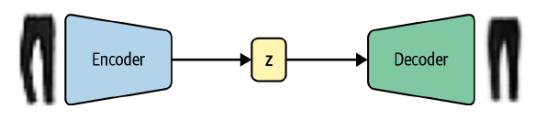
Autoencoder Architecture
An input image is encoded to a latent embedding vector z, which is then decoded back to the original pixel space
Why would you want to reconstruct a set of images that you already have available to you?
It is the embedding space (also called the latent space) that is the interesting part of the autoencoder, as sampling from this space will allow us to generate new images

Slide 7
The Embedding
The embedding (z) is a compression of the original image into a lower-dimensional latent space
The idea is that by choosing any point in the latent space, we can generate novel images by passing this point through the decoder
The decoder has learned how to convert points in the latent space into viable images, we can leverage that by providing slightly new points

Slide 8
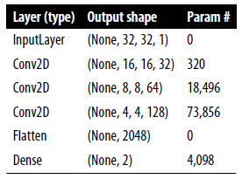
The Encoder
The encoder’s job is to take the input image and map it to an embedding vector in the latent space
To achieve this, we first create an Input layer for the image and pass this through three Conv2D layers in sequence, each capturing increasingly high-level features
We use a stride of 2 to halve the size of the output of each layer, while increasing the number of channels
The last convolutional layer is flattened and connected to a Dense layer of size 2, which represents our two-dimensional latent space

Slide 9
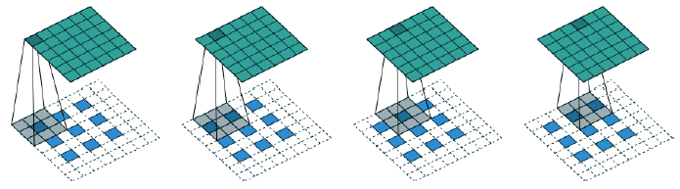
The Decoder
The decoder is a mirror image of the encoder—instead of convolutional layers, we use convolutional transpose layers
The convolutional transpose layer uses the same principle as a standard convolutional layer (passing a filter across the image), but is different in that it increases the size of the input tensor in both dimensions.

Slide 10
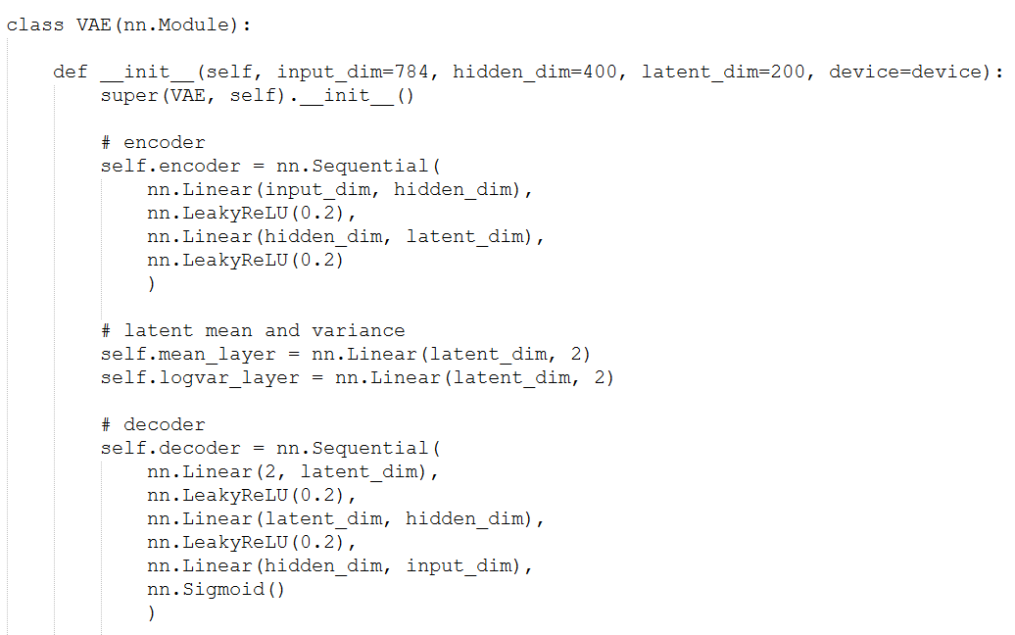
Join the Encoder and Decoder
To train the encoder and decoder simultaneously, we need to define a model that will represent the flow of an image through the encoder and back out through the decoder
Now that we’ve defined our model, we just need to compile it with a loss function and optimizer
Root mean squared error or binary cross-entropy between pixels

Slide 11
Differences in Loss Functions
Optimizing for RMSE means that your generated output will be symmetrically distributed around the average pixel values
Overestimation == Underestimation
Binary cross-entropy loss is asymmetrical—it penalizes errors toward the extremes more heavily than errors toward the center
This has the effect of binary cross-entropy loss producing slightly blurrier images than RMSE loss (as it tends to push predictions toward 0.5), but sometimes this is desirable as RMSE can lead to obviously pixelized edges

Slide 12
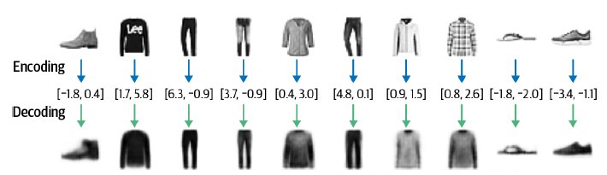
Reconstruction
We can test the ability to reconstruct images by passing images from the test set through the autoencoder and comparing the output to the original images
Notice how the reconstruction isn’t perfect—there are still some details of the original images that aren’t captured by the decoding process, such as logos

Slide 13
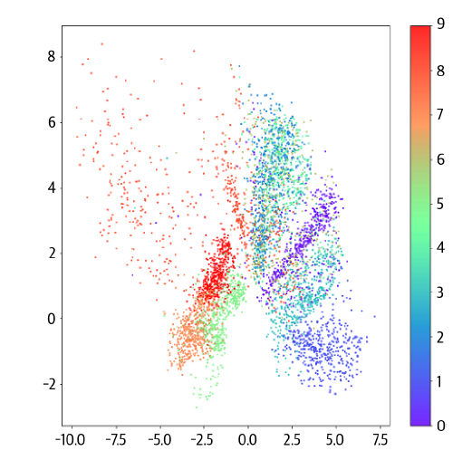
Visualizing Latent Spaces
We can visualize how images are embedded into the latent space by passing the test set through the encoder and plotting the resulting embeddings
We can make use of the labels that come with the Fashion-MNIST dataset, describing the type of item in each image

Slide 14
Generating New Images
We can generate novel images by sampling some points in the latent space and using the decoder to convert these back into pixel space
def generate_digit(mean, var):
z_sample = torch.tensor([[mean, var]], dtype=torch.float).to(device)
x_decoded = model.decode(z_sample)
digit = x_decoded.detach().cpu().reshape(28, 28) # reshape vector to 2d array
plt.imshow(digit, cmap='gray')
plt.axis('off')
plt.show()
generate_digit(0.0, 1.0), generate_digit(1.0, 0.0)

Slide 15
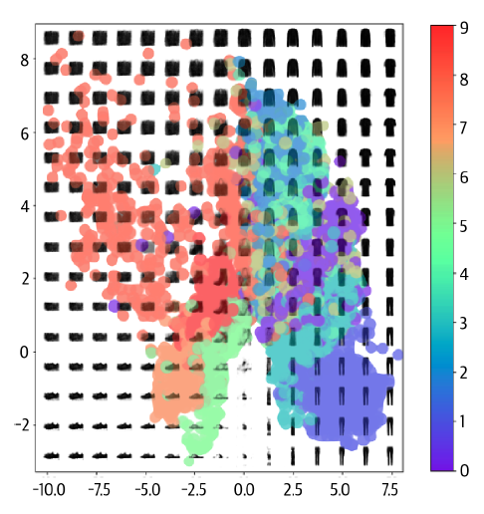
Points on the Distribution of Data
Some clothing items are represented over a very small area and others over a much larger area.
The distribution is not symmetrical about the point (0, 0), or bounded. For example, there are far more points with positive y-axis values than negative, and some points even extend to a y-axis value > 8.
There are large gaps between colors containing few points.

Slide 16
Issues with the Distribution
If we pick points uniformly in a bounded space that we define, we’re more likely to sample something that decodes to look like a bag
It is not obvious how we should go about choosing a random point in the latent space, since the distribution of these points is undefined
We can see holes in the latent space where none of the original images are encoded
In order to solve these three problems, we need to convert our autoencoder into a variational autoencoder

Slide 17
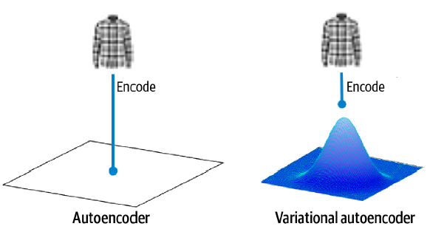
How to Convert
The two parts that we need to change are the encoder and the loss function
In an autoencoder, each image is mapped directly to one point in the latent space
In a variational autoencoder, each image is instead mapped to a multivariate normal distribution around a point in the latent space

Slide 18
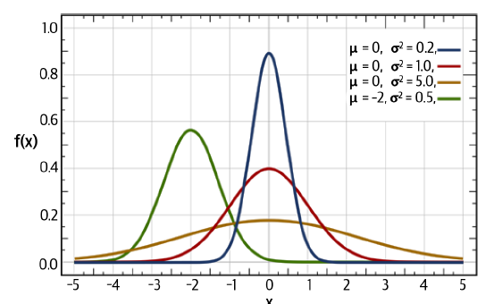
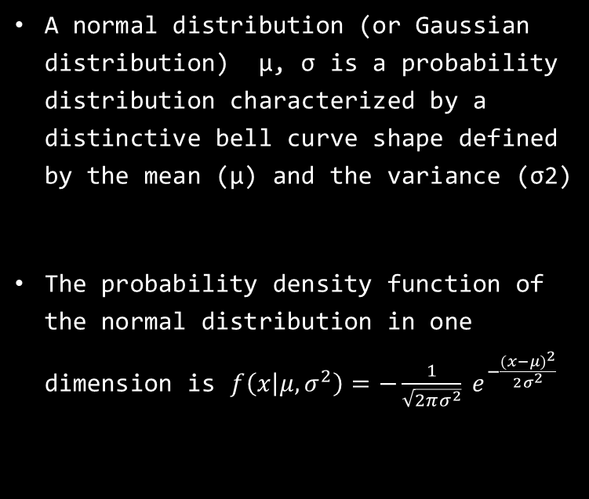
The Multivariate Normal Distribution
A normal distribution (or Gaussian distribution) μ, σ is a probability distribution characterized by a distinctive bell curve shape defined by the mean (μ) and the variance (σ2)
The probability density function of the normal distribution in one dimension is $f\left(x | μ,σ^{2}\right)=−\frac{1}{\sqrt{2πσ^{2}}} e^{−\frac{(x−μ)^{2}}{2σ^{2}}}$

Slide 19
The Variational Autoencoder
The encoder only needs to map each input to a mean vector and a variance vector and does not need to worry about covariance between dimensions
Variational autoencoders assume that there is no correlation between dimensions in the latent space
Variance values are always positive so we choose to map to the logarithm of the variance, as this can take any real number in the range (−∞, ∞)
Use a neural network as the encoder to perform the mapping from the input image to the mean and log variance vectors

Slide 20
VAE Cont.
The encoder will take each input image and encode it to two vectors that together define a multivariate normal distribution in the latent space
z_mean
The mean point of the distribution
z_log_var
The logarithm of the variance of each dimension
We can sample a point z from the distribution defined by these values using the following equation:
z = z_mean + z_sigma * epsilon
In the case where:
z_sigma = exp(z_log_var * 0.5)
epsilon ~ N(0,I)

Slide 21
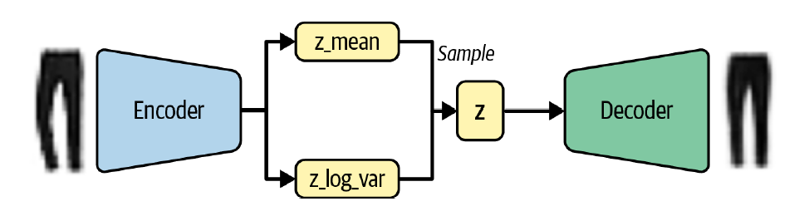
VAE Architecture

Slide 22
Difference from Autoencoder
Previously, we saw that there was no requirement for the latent space to be continuous
If the point (–2, 2) decodes to a well-formed image of a sandal, there’s no requirement for (–2.1, 2.1) to look similar
Now we are sampling a random point from an area around a mean, the decoder must ensure that all points in the same neighborhood produce similar images

Slide 23
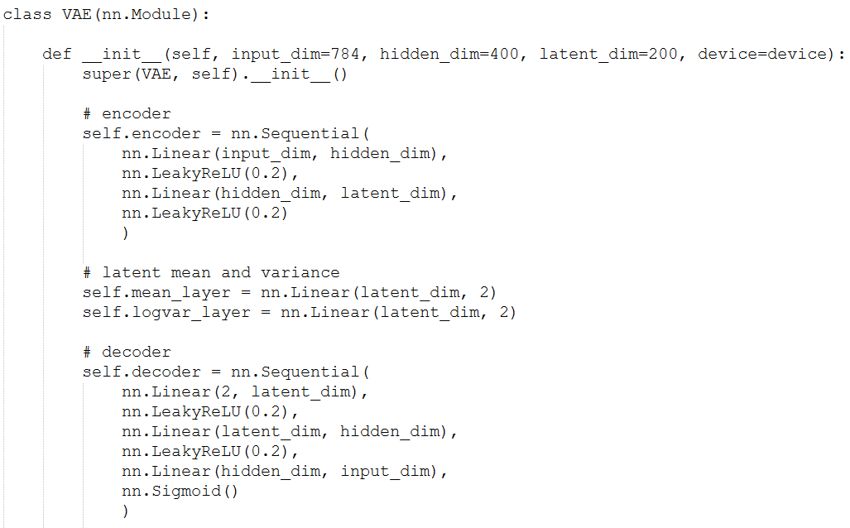
VAE in Torch

Slide 24
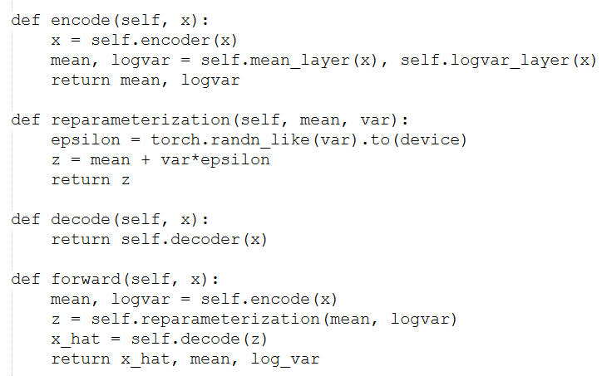
Remaining VAE Functions

Slide 25
What is Reparameterization Trick?
Changing the network from mapping input data points to latent variables (autoencoder) to mapping input data points to multivariate normal distributions introduces stochasticity
Directly sampling from the Gaussian distribution defined by μ and σ would introduce a random node into the computational graph, preventing the gradients from flowing back from the sampled latent variables to the encoder parameters
Therefore, we decompose the sampling process into 2 distinct components
Stochastic: A noise term ϵ is sampled from a standard normal distribution N(0,I), which is independent of the model parameters
Deterministic: The actual latent variable z is then computed using the deterministic function z = μ + σ x ϵ

Slide 26
Why Do We Care About Reparameterization?
Backpropagation can’t deal with randomness; we don’t know how much weight to assign to how incorrect that random

